Slide 1
Lecture 8
Applications of Genetic Algorithms
Yaohang Li
Department of Computer Science
ODU
Reading for Next Class:
Chapter 3, Russell and Norvig

Slide 2
Review
Last Class
Introduction to Genetic Algorithm
This Class
More on Genetic Algorithm
Travelling Salesman Problem
Differential Evolution
Assignment 2
Next Class
Constraint Satisfaction Problem

Slide 3
A Simple Example
“The Gene is by far the most sophisticated program around.”
- Bill Gates, Business Week, June 27, 1994

Slide 4
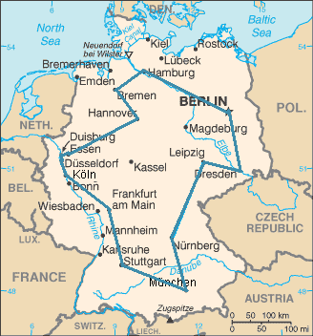
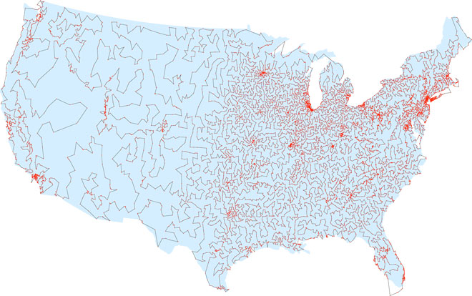
A Simple Example
The Traveling Salesman Problem:
Find a tour of a given set of cities so that
each city is visited only once
the total distance traveled is minimized
Finding a solution is NP-hard

Slide 5
Representation
Representation is an ordered list of city
numbers known as an order-based GA.
1) London 3) Dunedin 5) Beijing 7) Tokyo
2) Venice 4) Singapore 6) Phoenix 8) Victoria
CityList1 (3 5 7 2 1 6 4 8)
CityList2 (2 5 7 6 8 1 3 4)

Slide 6
Mutation operators for permutations
Normal mutation operators lead to inadmissible solutions
e.g. bit-wise mutation : let gene i have value j
changing to some other value k would mean that k occurred twice and j no longer occurred
Therefore must change at least two values
Mutation parameter now reflects the probability that some operator is applied once to the whole string, rather than individually in each position

Slide 7
Insert Mutation for permutations
Pick two allele values at random
Move the second to follow the first, shifting the rest along to accommodate
Note that this preserves most of the order and the adjacency information

Slide 8
Swap mutation for permutations
Pick two alleles at random and swap their positions
Preserves most of adjacency information (4 links broken), disrupts order more

Slide 9
Inversion mutation for permutations
Pick two alleles at random and then invert the substring between them.
Preserves most adjacency information (only breaks two links) but disruptive of order information

Slide 10
Scramble mutation for permutations
Pick a subset of genes at random
Randomly rearrange the alleles in those positions
(note subset does not have to be contiguous)

Slide 11
Crossover operators for permutations
“Normal” crossover operators will often lead to inadmissible solutions
Many specialised operators have been devised which focus on combining order or adjacency information from the two parents
1 2 3 4 5
1 2 3 2 1
5 4 3 2 1
5 4 3 4 5

Slide 12
Order 1 crossover
Idea is to preserve relative order that elements occur
Informal procedure:
1. Choose an arbitrary part from the first parent
2. Copy this part to the first child
3. Copy the numbers that are not in the first part, to the first child:
starting right from cut point of the copied part,
using the order of the second parent
and wrapping around at the end
4. Analogous for the second child, with parent roles reversed

Slide 13
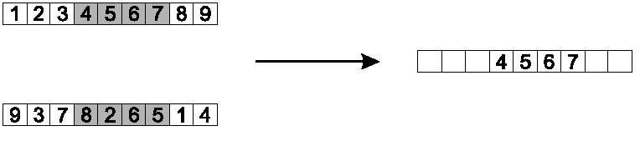
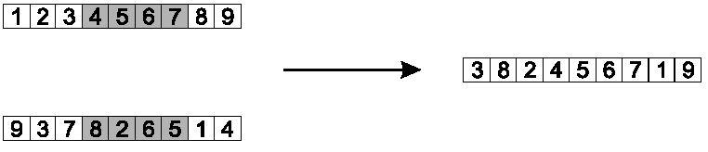
Order 1 crossover example
Copy randomly selected set from first parent
Copy rest from second parent in order 1,9,3,8,2

Slide 14
Partially Mapped Crossover (PMX)
Informal procedure for parents P1 and P2:
Choose random segment and copy it from P1
Starting from the first crossover point look for elements in that segment of P2 that have not been copied
For each of these i look in the offspring to see what element j has been copied in its place from P1
Place i into the position occupied j in P2, since we know that we will not be putting j there (as is already in offspring)
If the place occupied by j in P2 has already been filled in the offspring k, put i in the position occupied by k in P2
Having dealt with the elements from the crossover segment, the rest of the offspring can be filled from P2.
Second child is created analogously

Slide 15
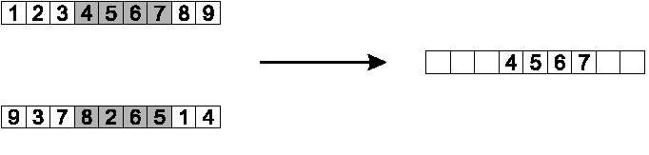
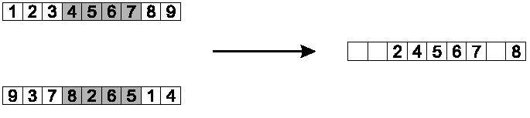
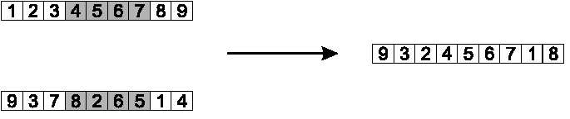
PMX example
Step 1
Step 2
Step 3

Slide 16
Cycle crossover
Basic idea:
Each allele comes from one parent together with its position.
Informal procedure:
1. Make a cycle of alleles from P1 in the following way.
(a) Start with the first allele of P1.
(b) Look at the allele at the same position in P2.
(c) Go to the position with the same allele in P1.
(d) Add this allele to the cycle.
(e) Repeat step b through d until you arrive at the first allele of P1.
2. Put the alleles of the cycle in the first child on the positions they have in the first parent.
3. Take next cycle from second parent

Slide 17
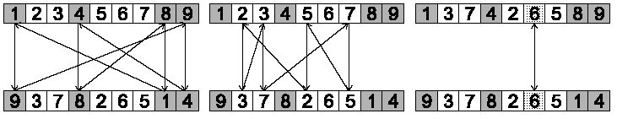
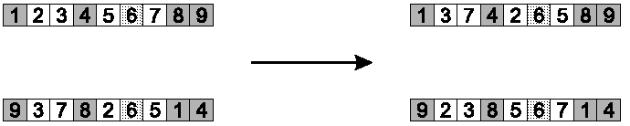
Cycle crossover example
Step 1: identify cycles
Step 2: copy alternate cycles into offspring

Slide 18
TSP Example: 30 Cities

Slide 19
Solution at 3rd generation (Distance=941)

Slide 20
Solution at 5th generation (Distance=800)

Slide 21
Solution at 10th generation (Distance=652)

Slide 22
Solution at 1,000 Generations (Distance=420)

Slide 23
Performance Overview

Slide 24
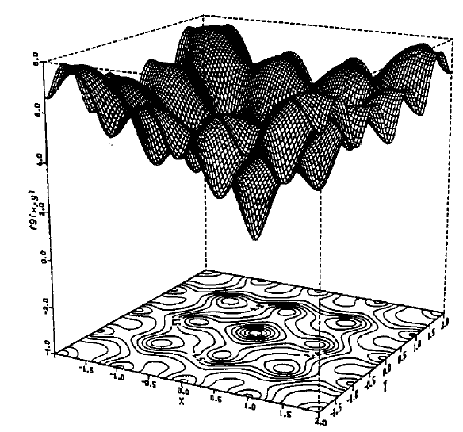
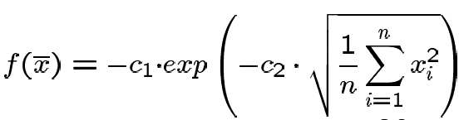

Real valued problems
Many problems occur as real valued problems, e.g. continuous parameter optimization f : ℜ ^{n} → ℜ
Illustration: Ackley’s function (often used in EC)

Slide 25
Formation of the problem
Global Optimization in Real Space
For an objective function f : X ⊆ R^{D} → R, the optimization problem is to find
x*∈X
such that f(x*) ≤ f(x) for all x ∈X

Slide 26
Differential Evolution
Stochastic, population-based optimization algorithm
Introduced by Storn and Price in 1996
Optimization for functions with real valued parameters
Popularly used in fields such as engineering, statistics, and finance
The objective function can be
Non-differentiable
Non-continuous
Non-linear
Noisy
Flat
Multi-dimensional
Multiple local minima
Constraint

Slide 27
Differential Evolution Algorithm

Slide 28
Differential Evolution Parameters
Parameters
Np: population size
Recommended for 10 times of the number of parameters (dimensions)
Nc: number of cycles
CR: crossover and recombination probability [0, 1)
Higher value – faster convergence
Lower value – better convergence
F: differential weight [0, 2]
Recommended F=0.8
Recent study shows that F as a random number of [0.5, 1] improves convergence

Slide 29
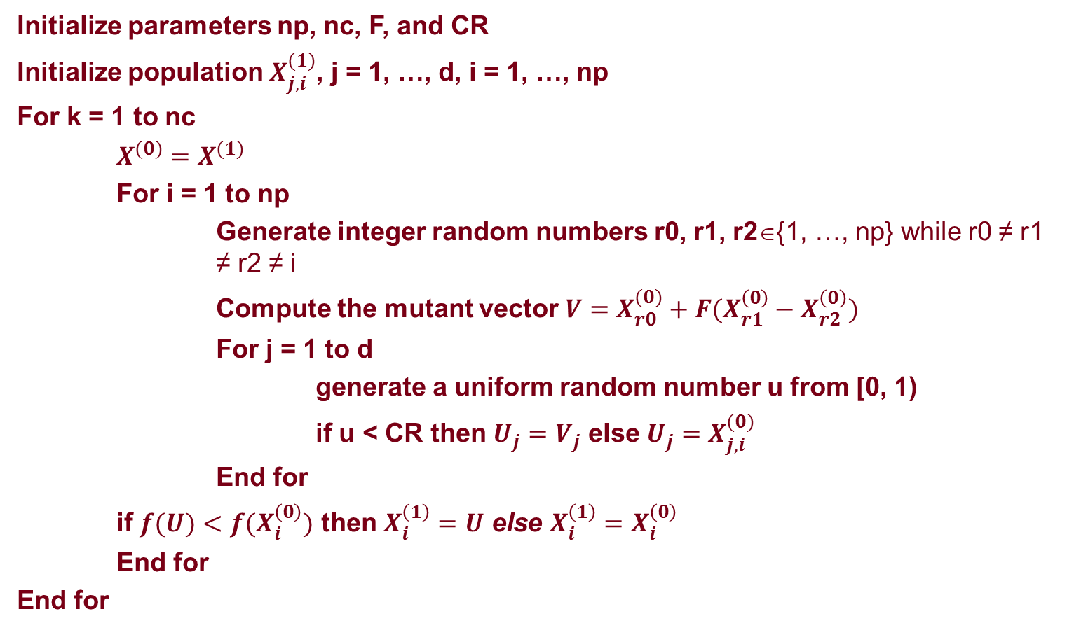
Differential Evolution Pseudo Code
Initialize parameters np, nc, F, and CR
Initialize population $X_{j,i}^{(1)}$, j = 1, …, d, i = 1, …, np
For k = 1 to nc
$X^{(0)}=X^{(1)}$
For i = 1 to np
Generate integer random numbers r0, r1, r2∈{1, …, np} while r0 ≠ r1 ≠ r2 ≠ i
Compute the mutant vector $V=X_{r0}^{(0)}+F(X_{r1}^{\left(0\right)}−X_{r2}^{\left(0\right)})$
For j = 1 to d
generate a uniform random number u from [0, 1)
if u < CR then $U_{j}=V_{j}$ else$U_{j}=X_{j,i}^{(0)}$
End for
if $f(U)<f(X_{i}^{\left(0\right)})$ then $X_{i}^{\left(1\right)}=U$ else $X_{i}^{\left(1\right)}=X_{i}^{\left(0\right)}$
End for
End for

Slide 30
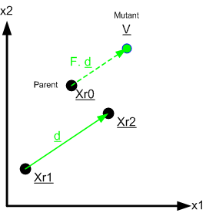
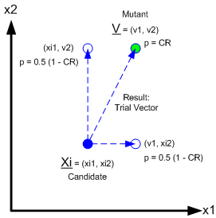
Mutation
Mutation
Recombination

Slide 31
Ackley’s function

Slide 32
Initialization

Slide 33
Mutation

Slide 34
Mutation

Slide 35
Mutation

Slide 36
Mutant Vector

Slide 37
Generation of New Vector

Slide 38
Recombination

Slide 39
Selection

Slide 40
Selection

Slide 41
Mutation

Slide 42
Mutation

Slide 43
Mutation

Slide 44
Mutation

Slide 45
Generation of New Vector

Slide 46
Recombination

Slide 47
Selection

Slide 48
Selection

Slide 49
Second Generation

Slide 50
Behavior of DE in Peaks Function
https://www.youtube.com/watch?v=quDsKPzw_wo&feature=player_embedded

Slide 51
Analysis of Differential Evolution
There is no proof of convergence for DE
However, DE has shown better convergence than Genetic Algorithm, Simulated Annealing, Controlled Random Search, and Evolutionary Programming

Slide 52
Summary
Genetic Algorithm
Crossover
Mutation
Application in Traveling Salesman Problem
Differential Evolution for Real Parameters

Slide 53
What I want you to do
Review Chapter 3
Work on your assignment
Organize your project team
Website for DE
http://www1.icsi.berkeley.edu/~storn/code.html

